Slide 1
Software Engineering
Project Presentation
19K-1411, 19K-0263, 19K-0297 & 19K0364
Section: 6E

Slide 2
Which Software Houses we visited..?
Systems
Folio3
Evoligence
We conducted a survey form and our target audience was software engineers working in Software Houses.

Slide 3

Importance of Software Engineering
Once we know what is software engineering we can estimate its importance. Software engineering defines process to develop software. It helps to carry out the life cycle of software, to select the software development team, to provide support of delivered software and to incorporate change. If there is no software engineering then no software can be developed.

Slide 4


Steps toward current trends
JIRA Working on Jira, we can have an insightful view of project.
Azure DevOps Use for repository management, we can make tasks and more.
Teams foundation Server Use for repository management and we can associate issues and task to our code for testing.
New trends do not discard the older one. Some projects are still developing on older technologies may be due to customer willing, or may be project is in support and have mature repository which can not be imported or changed.

Slide 5




Which Programming languages are being used in web Development?

Slide 6
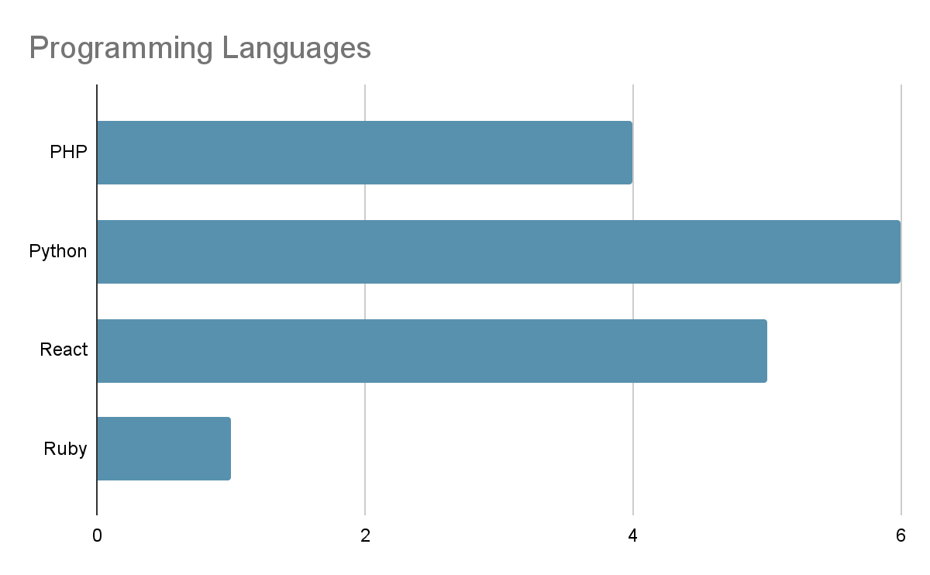

Slide 7
Which design patterns are mostly used?
Repository
Strategy
Singleton
Adapter
Factory
Key Points
Design Patterns are adaptable..
Easy for change management.
For designing any module design patterns are very helpful.

Slide 8
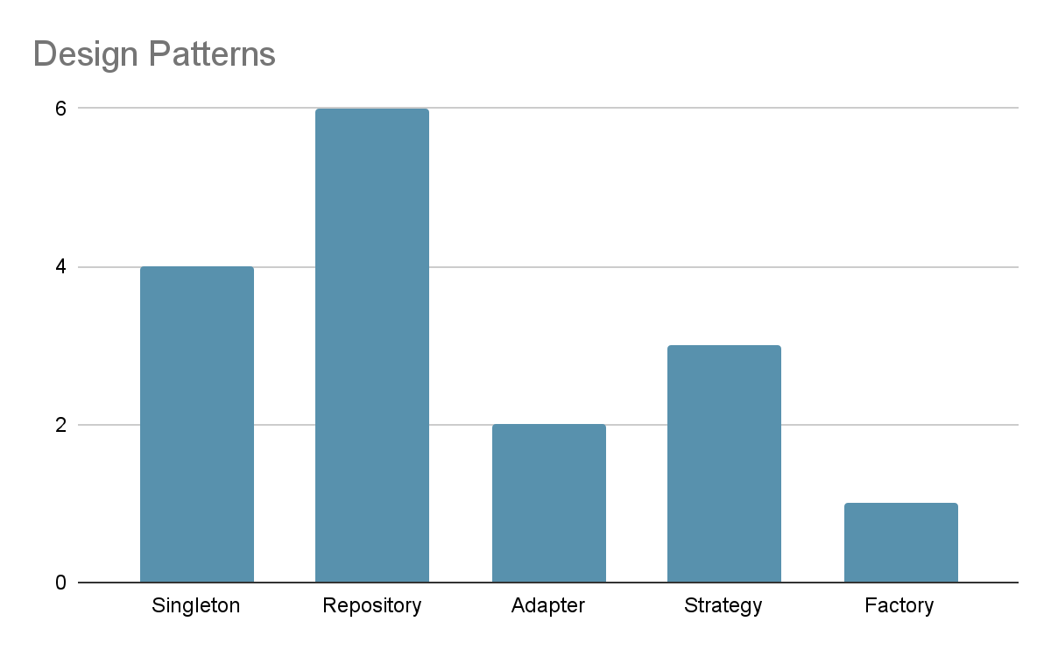

Slide 9

Let's suppose we want to develop an E-COMMERCE WEBSITE which methodology should be used?

Slide 10
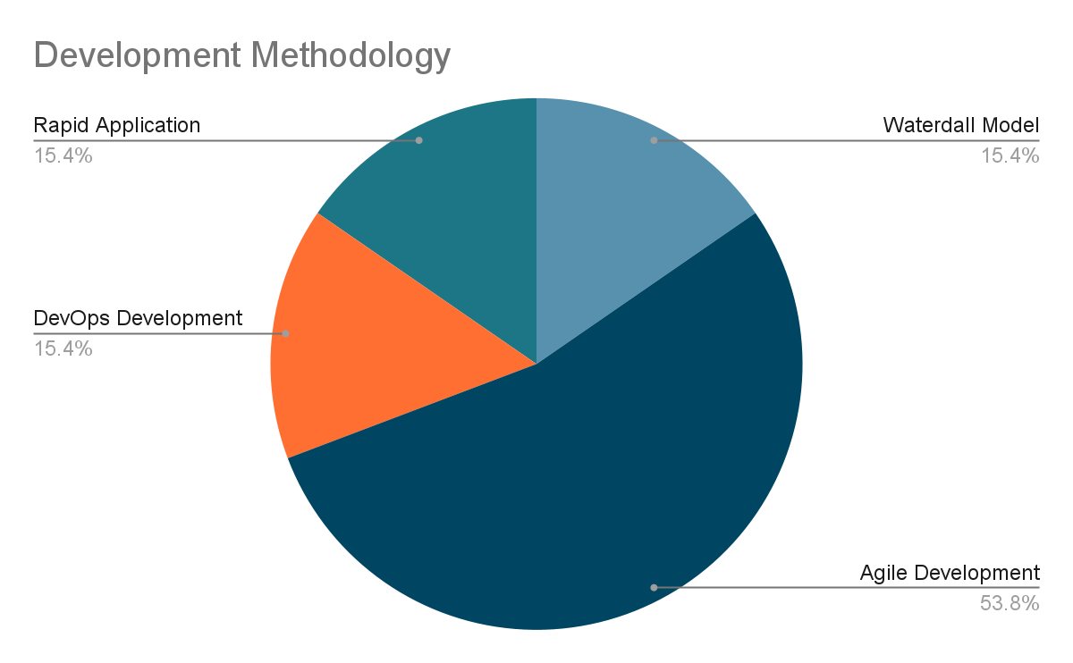

Slide 11
Which SDLC models are being used mostly?
Waterfall
Agile
V-Model
Iterative
Bigbang
Key Point
SDLC ensures the production of high-quality, low-cost software, in the shortest possible time.

Slide 12
How to avoid conflict with in team
Project Manager ensures to listen to everyone and find the solution.
When working with multiple teams, team lead perform a key role to avoid conflict with in teams.
Estimate the project completion accurately, and estimate it considering other teams. So that when you are done with your tasks then other team have enough time to do theirs.

Slide 13
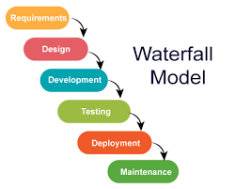
Waterfall over Agile
Waterfall has 50-50 chances that each task is dependent on each other.
We completely do requirement analysis and then go to development phase.
Few tasks do have to be implemented step by step.

Slide 14
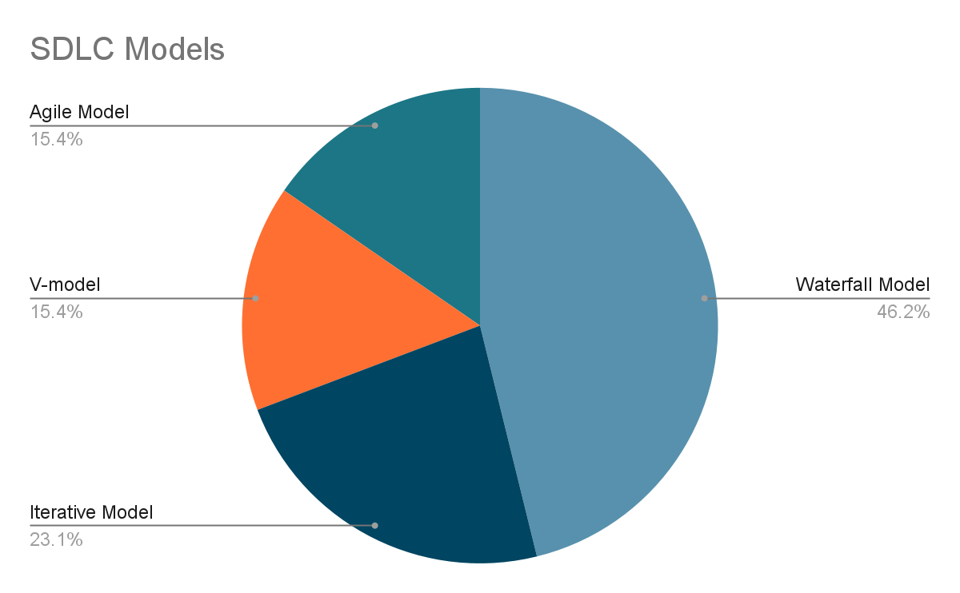

Slide 15
How to avoid Change
Software system that covers all the domain of requirements be able to easily modify.
Having on spot client meeting and validate them after every component development.
We set the agreement first and then we make project according to SRS and take customer satisfaction.
Using scrum development in which everyday 15 minutes meeting help changes efficiently and accurately.

Slide 16
How to test and find bugs?
Software tester or QA use requirement document which is SRS to write test cases. If bug is identified in early stages then cost of that bug will be minimum. Some of the testing types used: Automated Testing Scripted Testing Black Box Testing

Slide 17
Which test management tools are mostly used?
Jira
TestCollab
PractiTest
TestRail
Trello
BaseCamp
Key Points
Requirement document is very important
Bugs in early stages cause low-cost
Identify if any requirement do not support tool

Slide 18
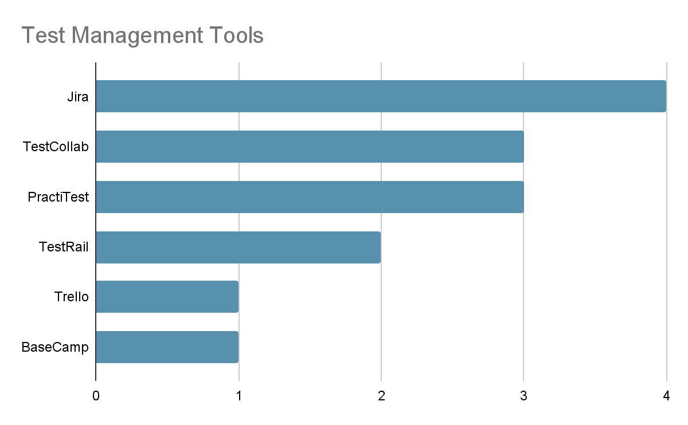

Slide 19
Which tools are being used for Software Testing?
Selenium
Katalon
TestingWhiz
UFT
TestProject
Key Point
Without software testing no product can be deployed…

Slide 20
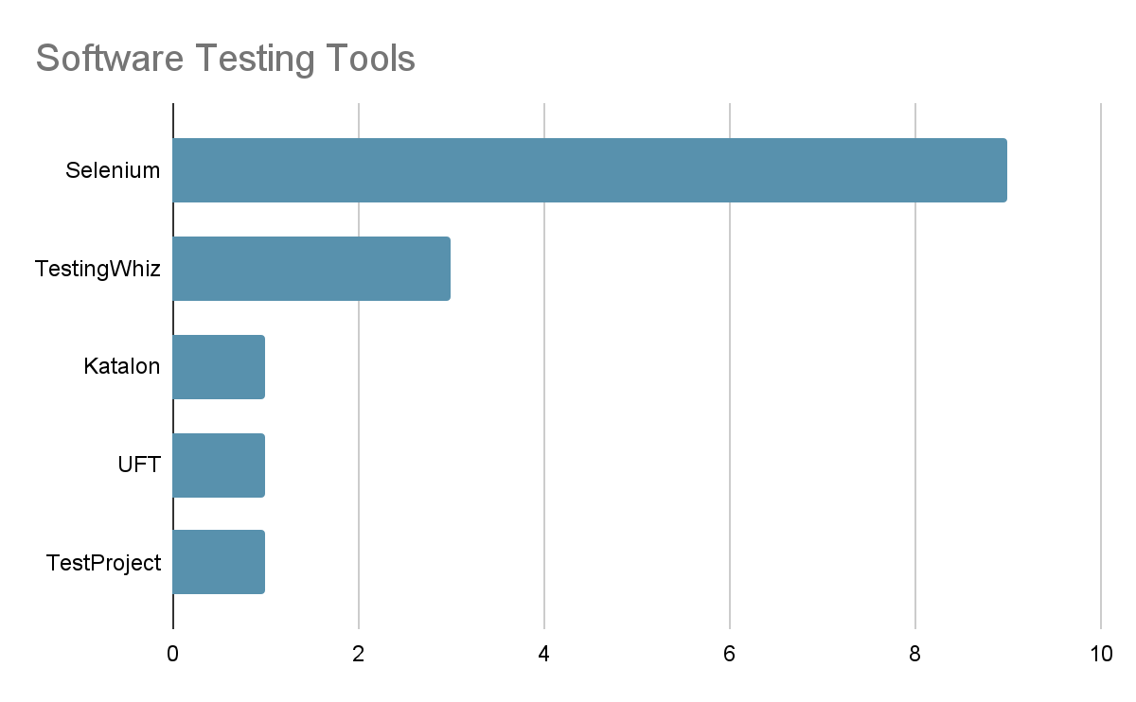

Slide 21
Links…
Recording link of meeting with System’s Software Developer(Mehwish Yousuf):
https://drive.google.com/drive/folders/13_eNnRwyjwCf2zWslpI0vsr9YVzFKuvY?usp=sharing
Recording link of meeting with System’s Software Tester(Intisar Ali & Mustafa Shabbir):
https://drive.google.com/file/d/1GM7rD3SEAS_hcv5OQ_fkLHBgcPmoV3Hb/view?usp=sharing
Google Survey form link:
https://docs.google.com/forms/d/e/1FAIpQLSf3112-eGGFskJ82Mq8mfCFBNQWTM0kqcoszjbg9HyyIGFROw/viewform?usp=sf_link

Slide 22
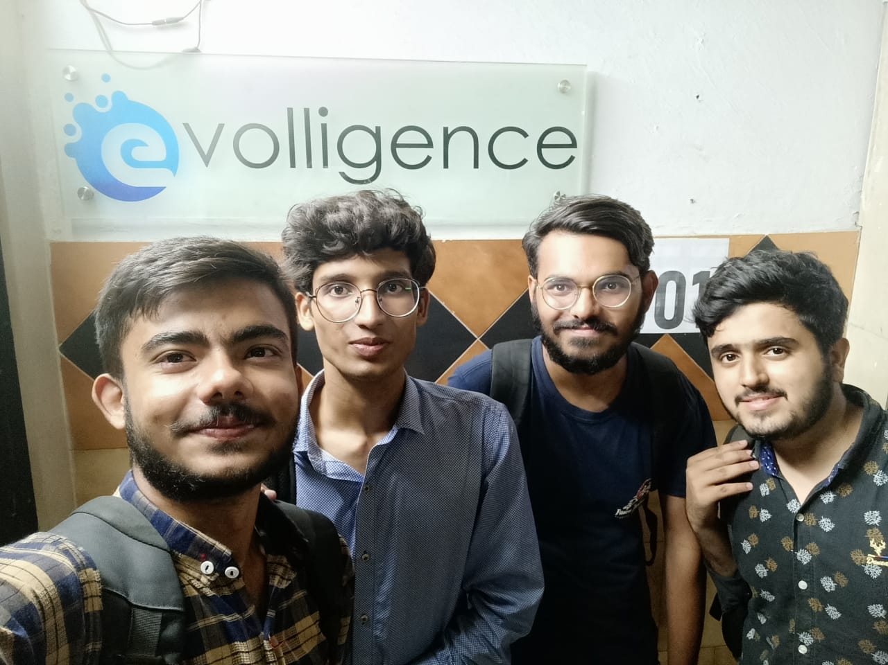

Slide 23
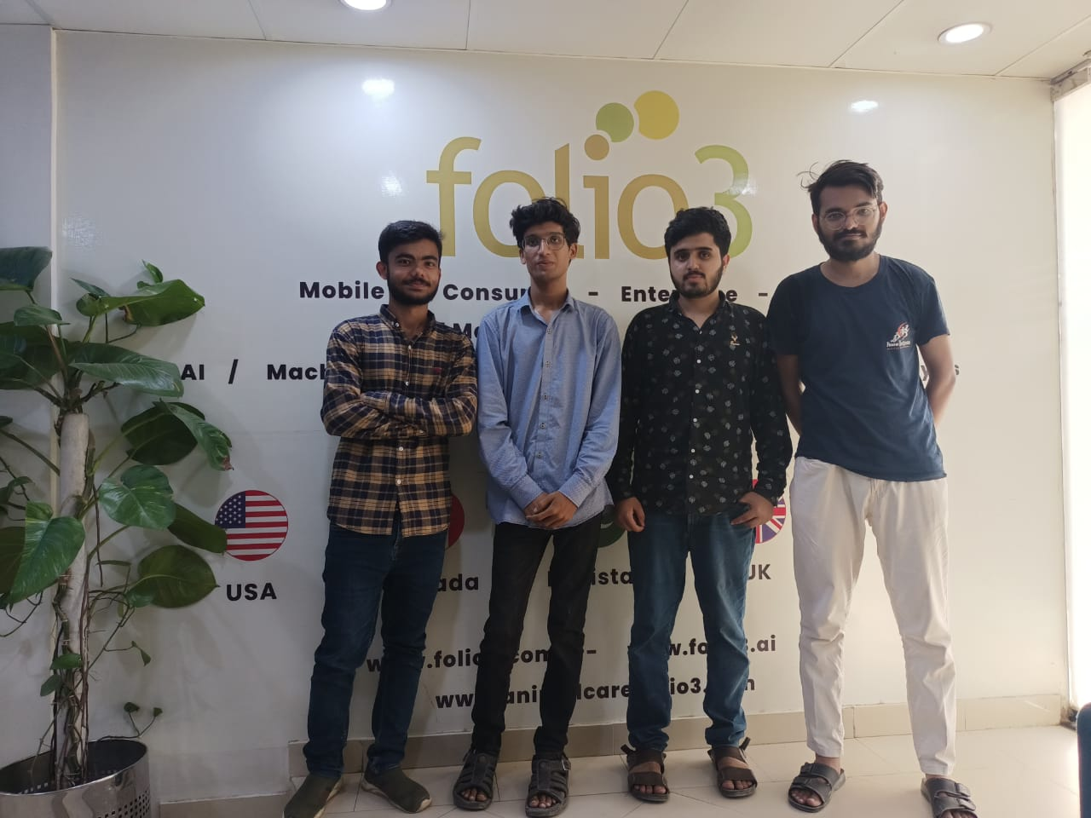

Slide 24
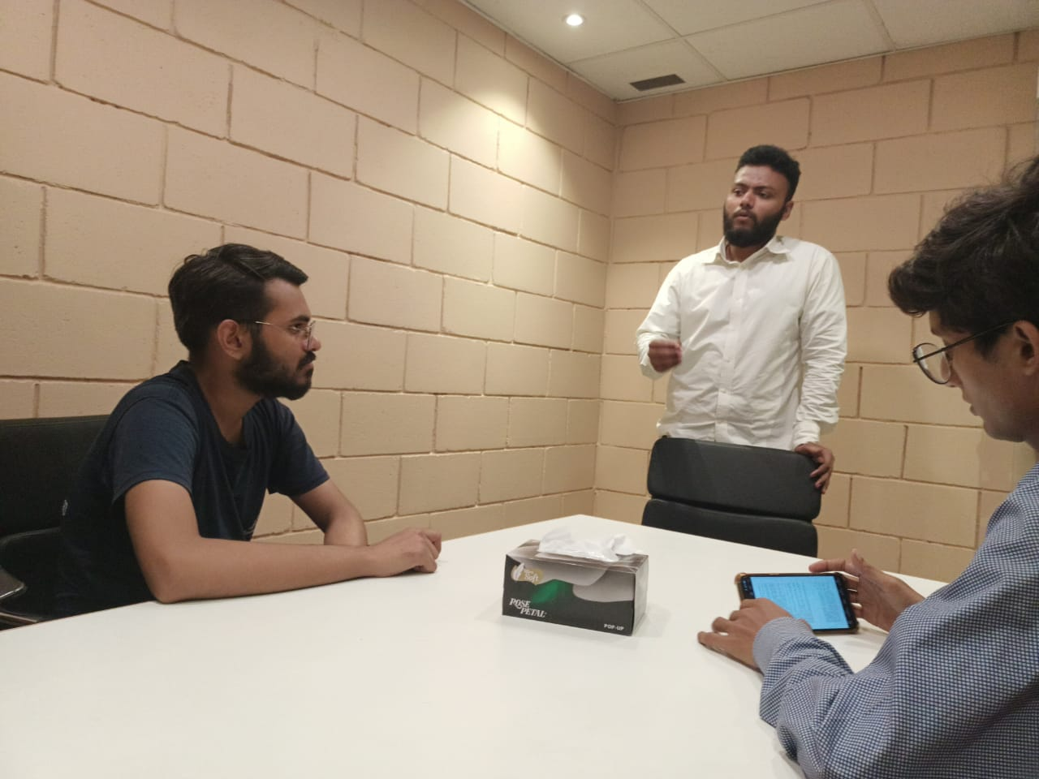

Slide 25
